Slide 1

SAP Datasphere Training – Day 3
www.anubhavtrainings.com

Slide 2
Agenda
Connectivity
01
Understand the connections with SAP Datasphere
Get started with Standard roles and Data Builder.
Cloud Connector
02
Create connection with Datasphere using Cloud Connector and DP agent
www.anubhavtrainings.com
HANA Cloud Introduction
03
SAP HANA Database with tables, views, and models. Create SAP BTP account with HANA Cloud
Connect to HANA Cloud
04
Connect to HANA Cloud system with Datasphere.

Slide 3
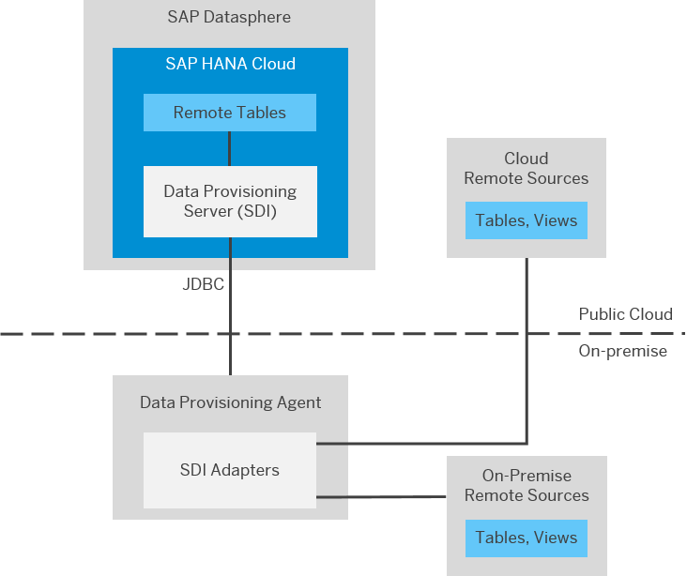
Data Provisioning Agent
The data provisioning agent is a light weight component running outside the SAP datasphere environment. It hosts data provisioning adaptors for connecting to remote sources, enabling data federation and replication scenario. The data provisioning agent acts a gateway to datasphere tenant providing a secure connection between database of datasphere and adapter based remote sources. This agent is managed by data provisioning server. It is required for all connections with SAP HANA SDI.
The interface used behind the scenes for connection is JDBC (Java Database connectivity). The DP agent needs to be installed in local host in your company network and needs to be configured with datasphere by IT administrator.
https://help.sap.com/docs/SAP_DATASPHERE/9f804b8efa8043539289f42f372c4862/8f6185069a51404ebf23c684fee8cf39.html?locale=en-US
Those who are using SAP Trial/Guided experience a/c of datasphere, a DP agent is preconfigured for us to do connectivity.

Slide 4
What is Cloud Connector?
Cloud Connector serves a link between SAP datasphere and your on-premise sources and is required for connections that we use for:
Data flows
Replication flows
Model import from BW/4HANA
Remote tables (only for SAP HANA op via SDA – smart data access)

Slide 5

Basics of Connectivity and Role of SCC
Internet
Intranet
SAP BW
SAP ECC
SAP S/4 Hana
SAP BW/4 SYSTEM
SAP BTP (PublicCloud)
SAP Cloud Connector
SAP On-premise System
SAP Datasphere
SCC
BTP Account
S/4 Hana Cloud
Field Glass
Sales Force

Slide 6
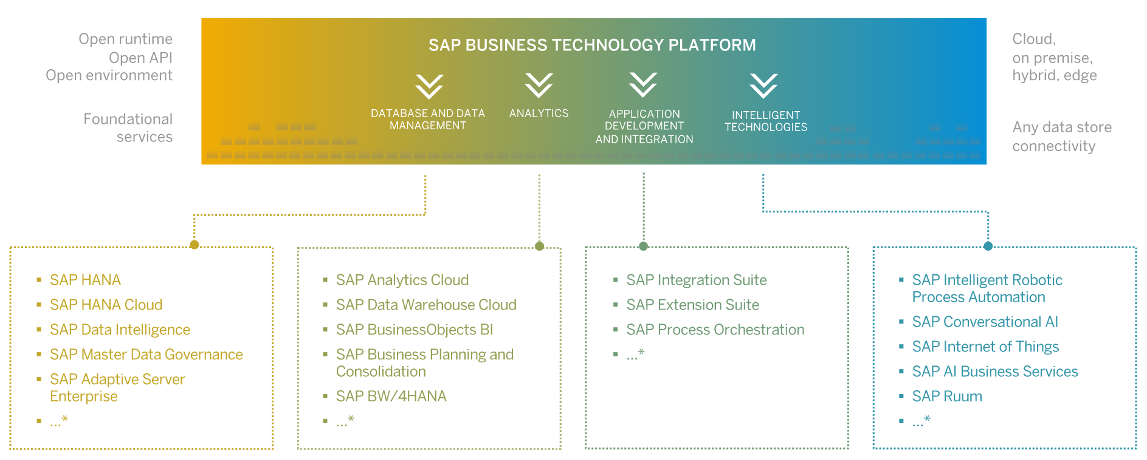
What is SAP BTP?
SAP Business Technology Platform (SAP BTP) is an integrated offering comprised of four technology portfolios: database and data management, application development and integration, analytics, and intelligent technologies. The platform offers users the ability to turn data into business value, compose end-to-end business processes, and build and extend SAP applications quickly.

Slide 7
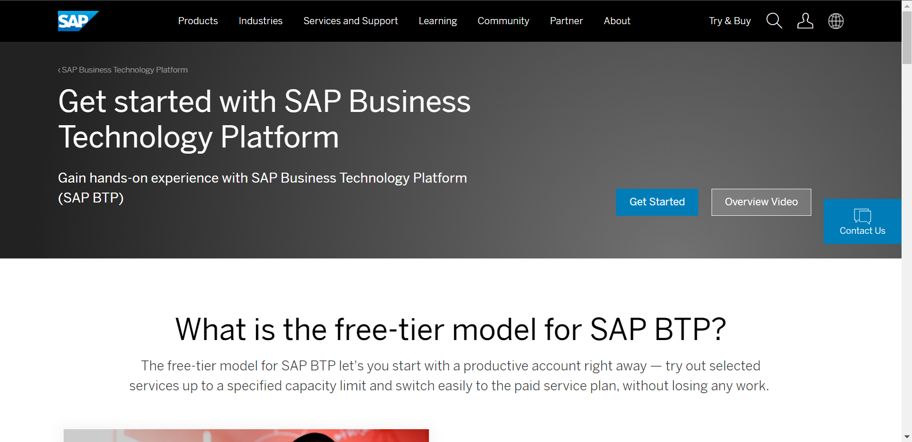
Setup your FREE BTP Account
To use SAP Business Technology Platform first you need to create a account on sap.
You can setup a free account for SAP at https://www.sap.com/products/cloud-platform.html
After account setup to access the Business Technology Platform trial account visit: https://account.hanatrial.ondemand.com/trial/#/home/trial

Slide 8
Customer View of BTP Account
Backing Services
Global Account
(Representation of customer for billing purpose)
Sub Account
(per region)
Specialized service offerings
Represents LoB
Space quotas
1 *
1 *
Space
1
*
Apps

Slide 9
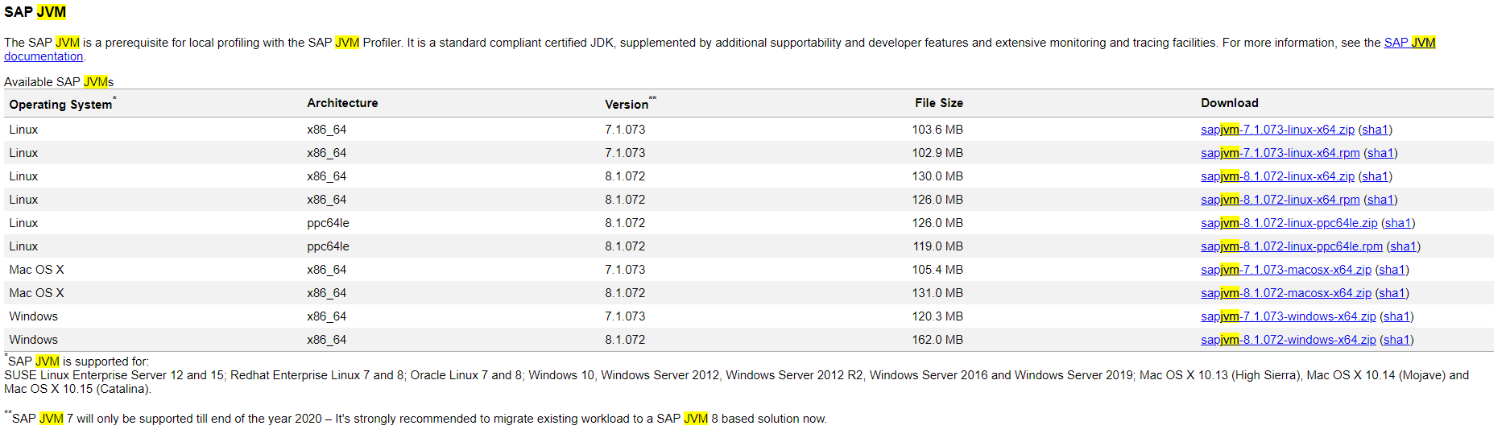
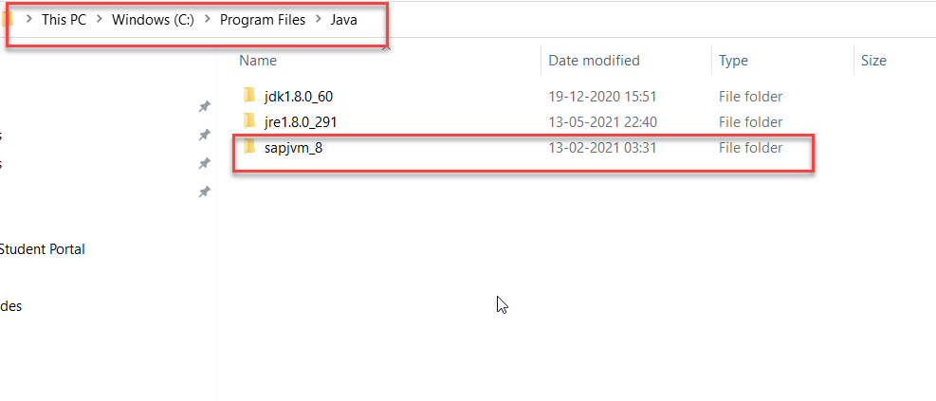
Cloud Connector
Step 1: Download SAP JVM and Extract it in the C:\Program Files\Java

Slide 10
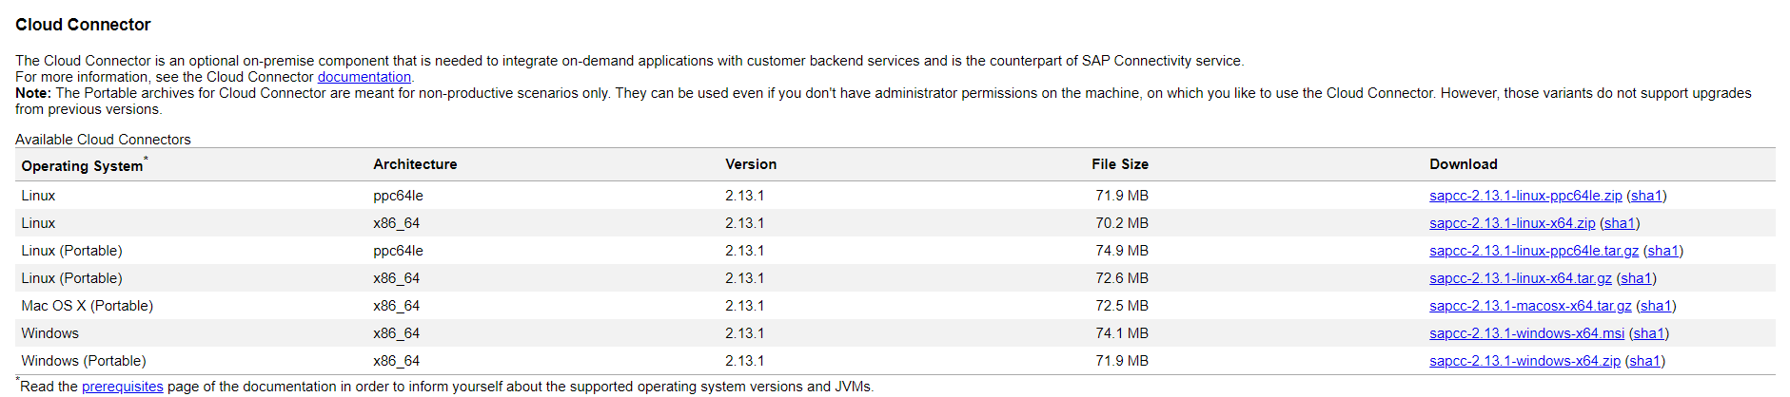
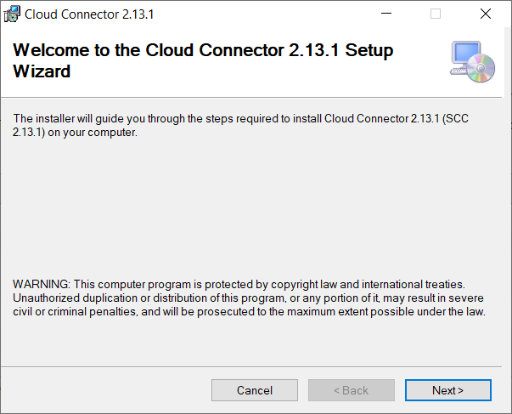
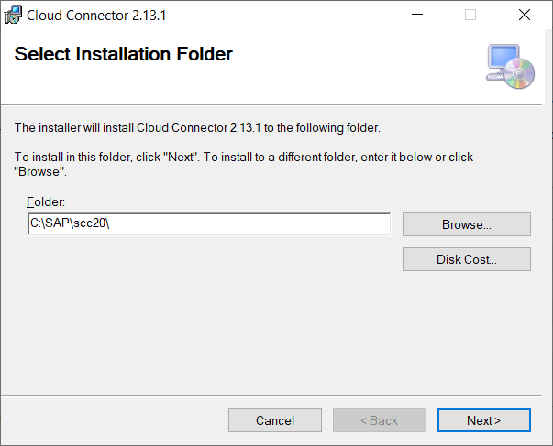
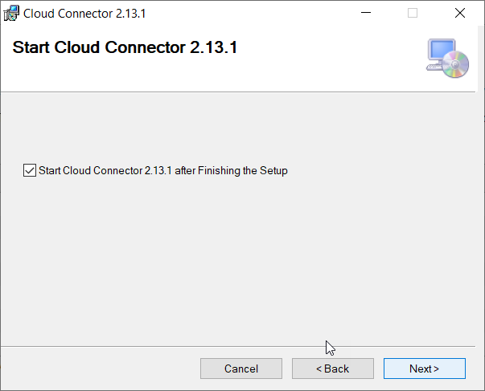
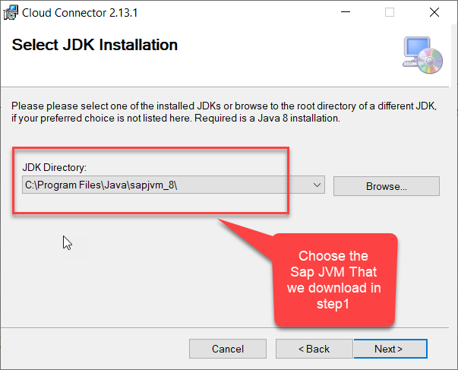
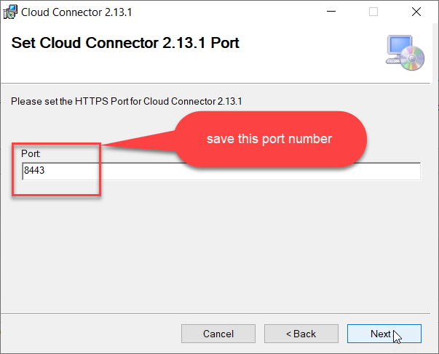
Cloud connector continue…
Step 2: Download and install the sap Cloud connector

Slide 11
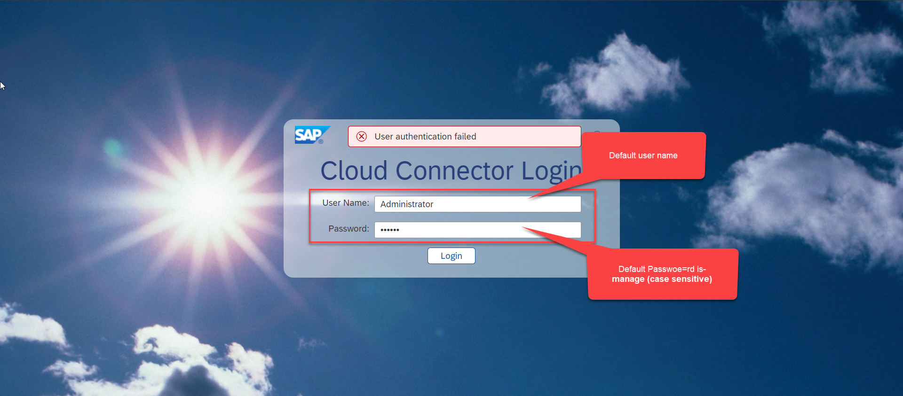
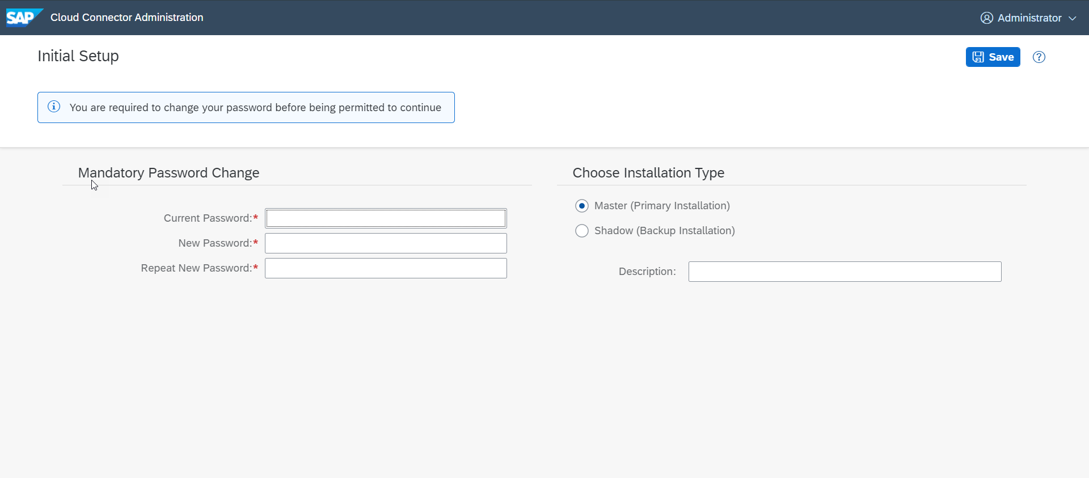
Cloud connector continue…
Step 3: Now your system is ready go to browser and open https://localhost:8443 (port may changes)
The default credentials are Administrator / manage

Slide 12
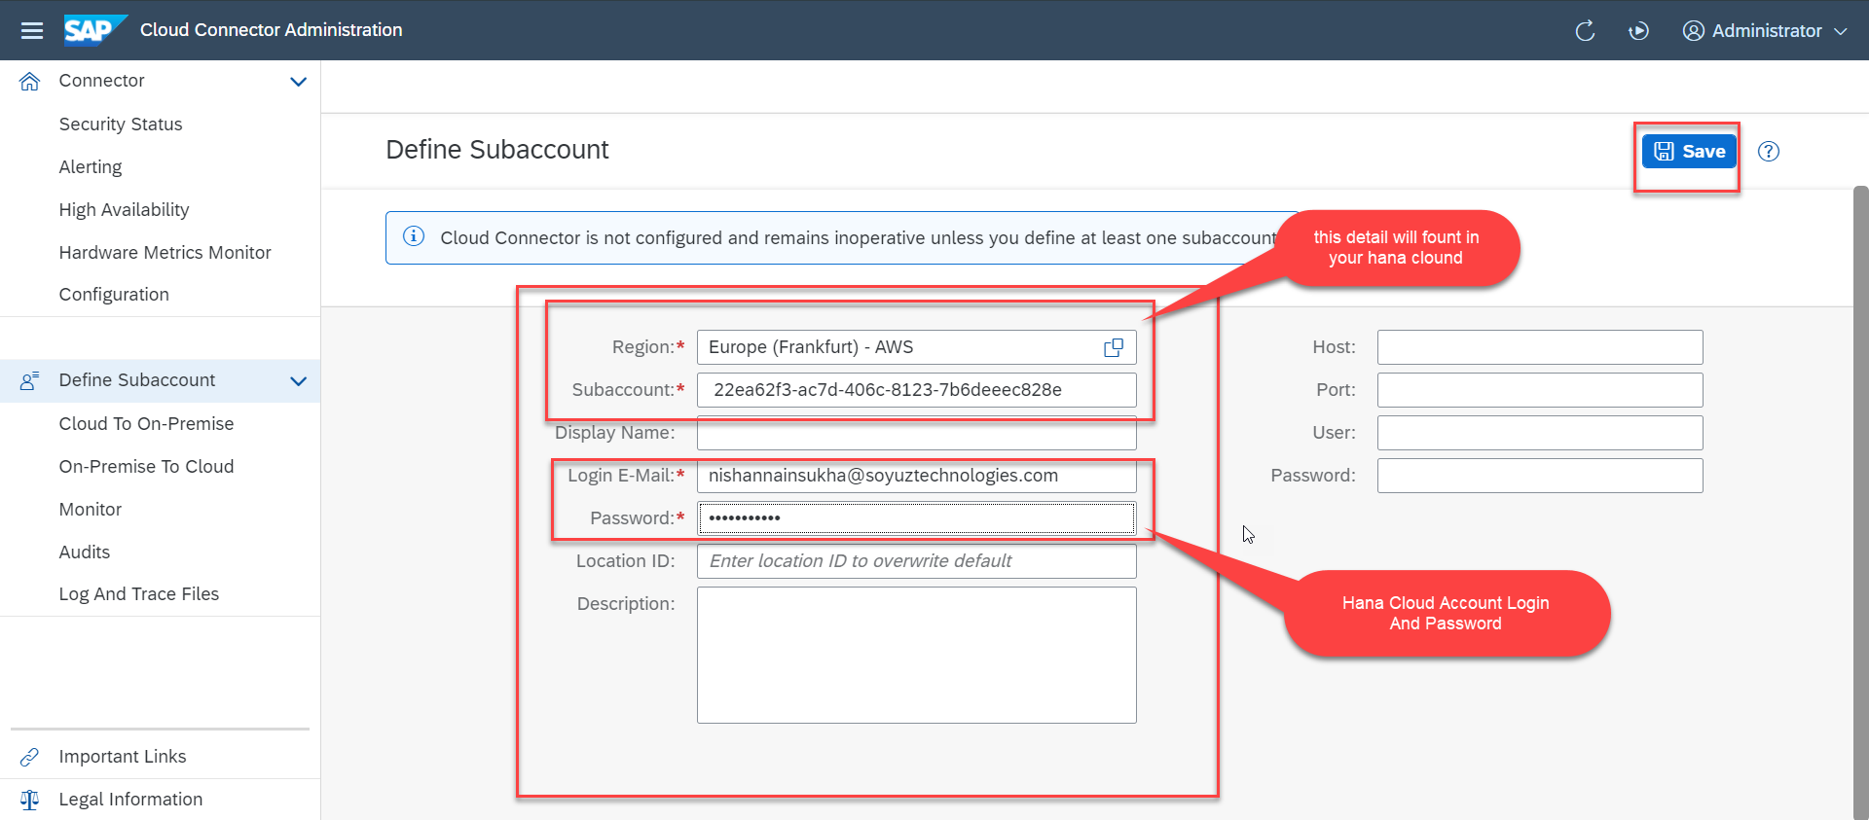
Cloud connector continue…
Step 4: Now we create a connection with our Cloud Account

Slide 13
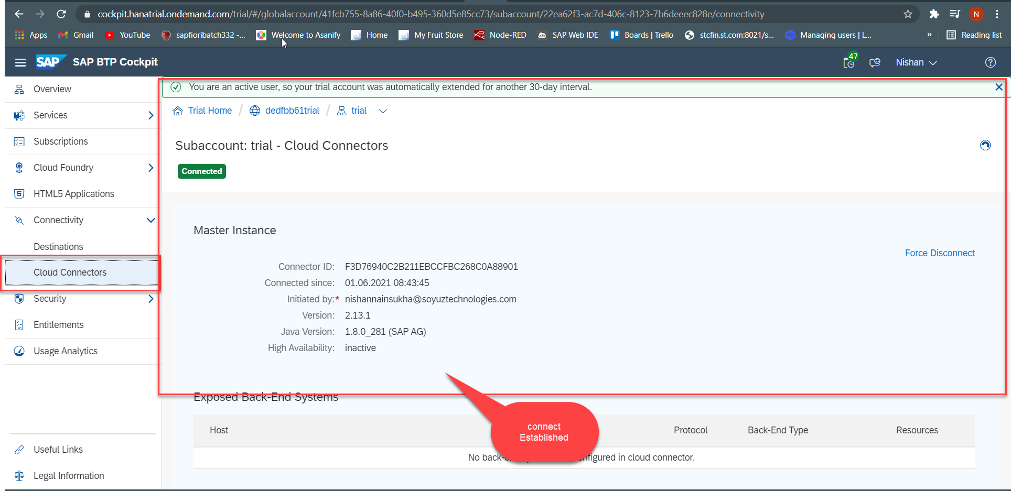
Cloud connector continue…
Step 5: Check the connection on Hana Cloud Account

Slide 14
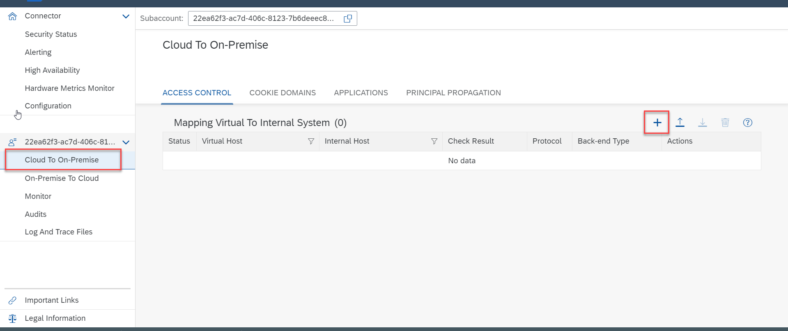
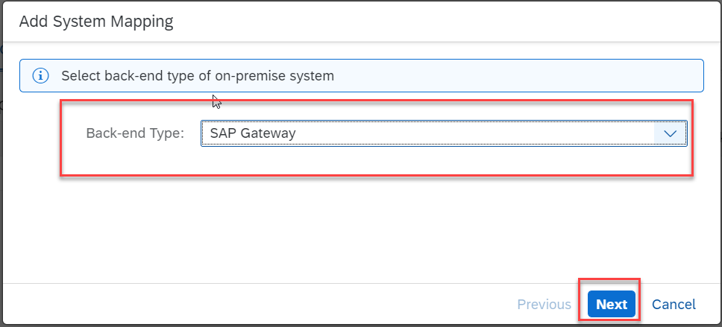
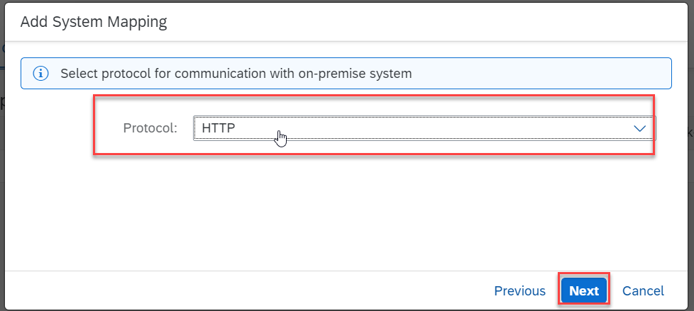
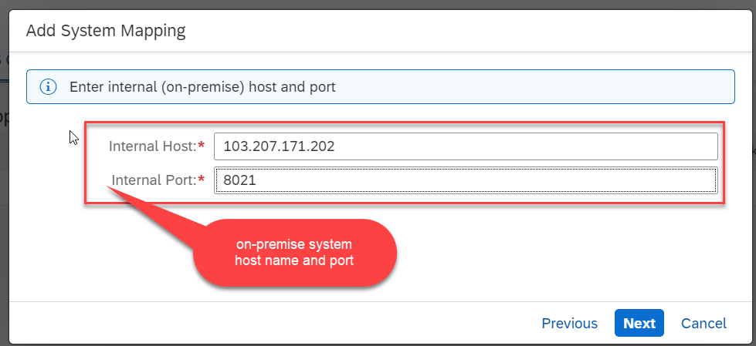
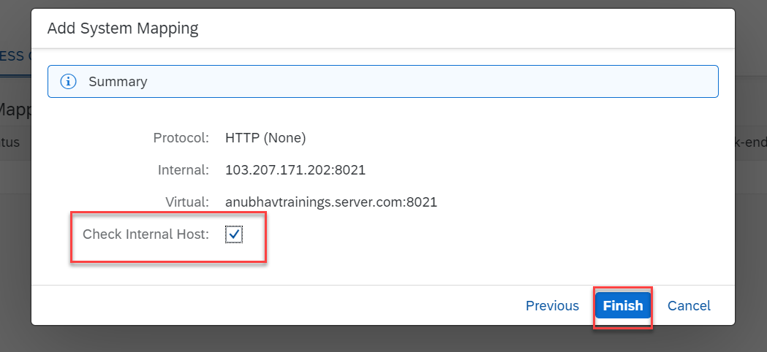
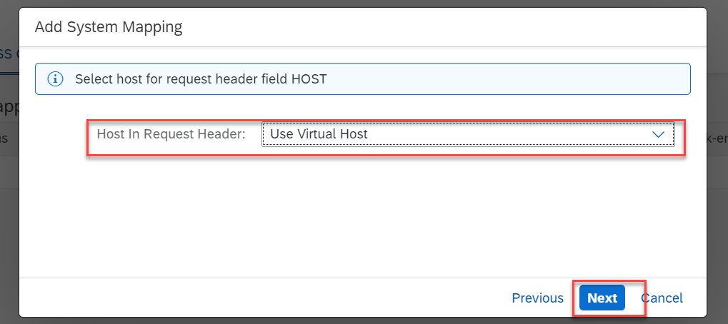
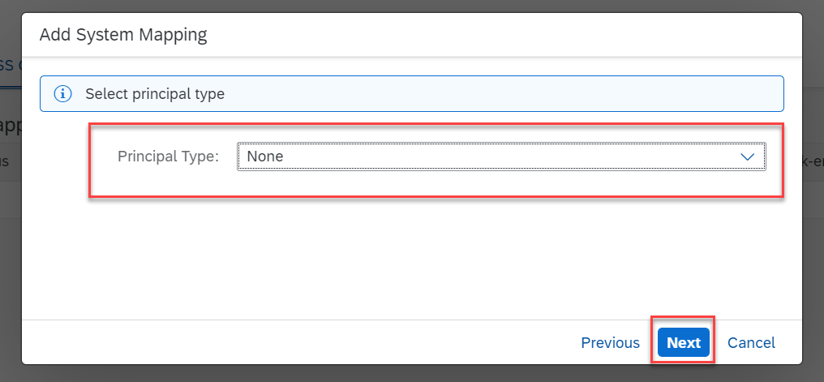
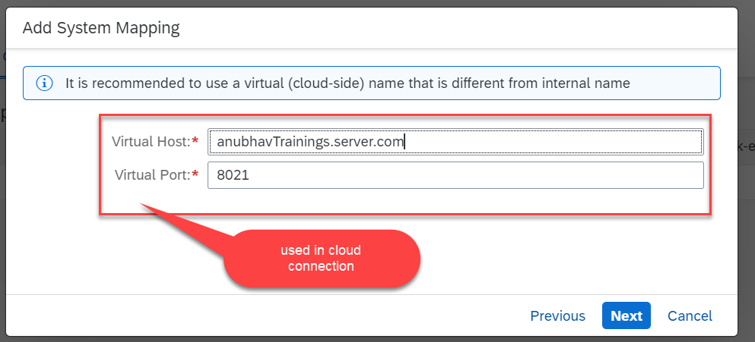
Cloud connector continue…
Step 6: Connect on-premise system to cloud using SCC

Slide 15
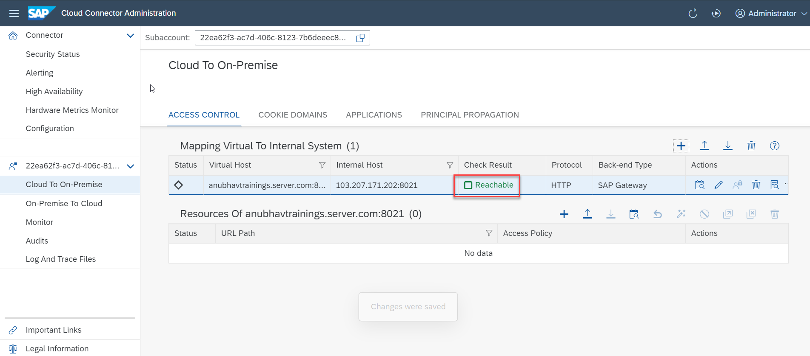
Cloud connector completed
We have Done with Connect , now we are now successfully connected to cloud using SCC.

Slide 16
Server Access
Anubhav training offers server access @ 2500 INR per user per month /40 USD
Directly available on cloud, S/4HANA cum BW system
It is latest S/4HANA 2021 with direct connection, NO VPN, NO RDP is required
Fully activated S/4HANA system with proper license
Used to practice All Anubhav’s courses
Available 24X7, The process for BW/4HANA, BW, ECC, S/4HANA, BPC remains same
SLA 2 H- 9.30 AM – 6.30 PM IST – All 7 Days
It has connectivity configuration done for datasphere and cloud connector
We will provide documentation, videos to connect to our server
Hi Team, I want to take S/4HANA server, please let me know cost in INR/USD currency and account details to transfer funds. Thanks. <Your name> --- server@anubhavtrainings.com

Slide 17
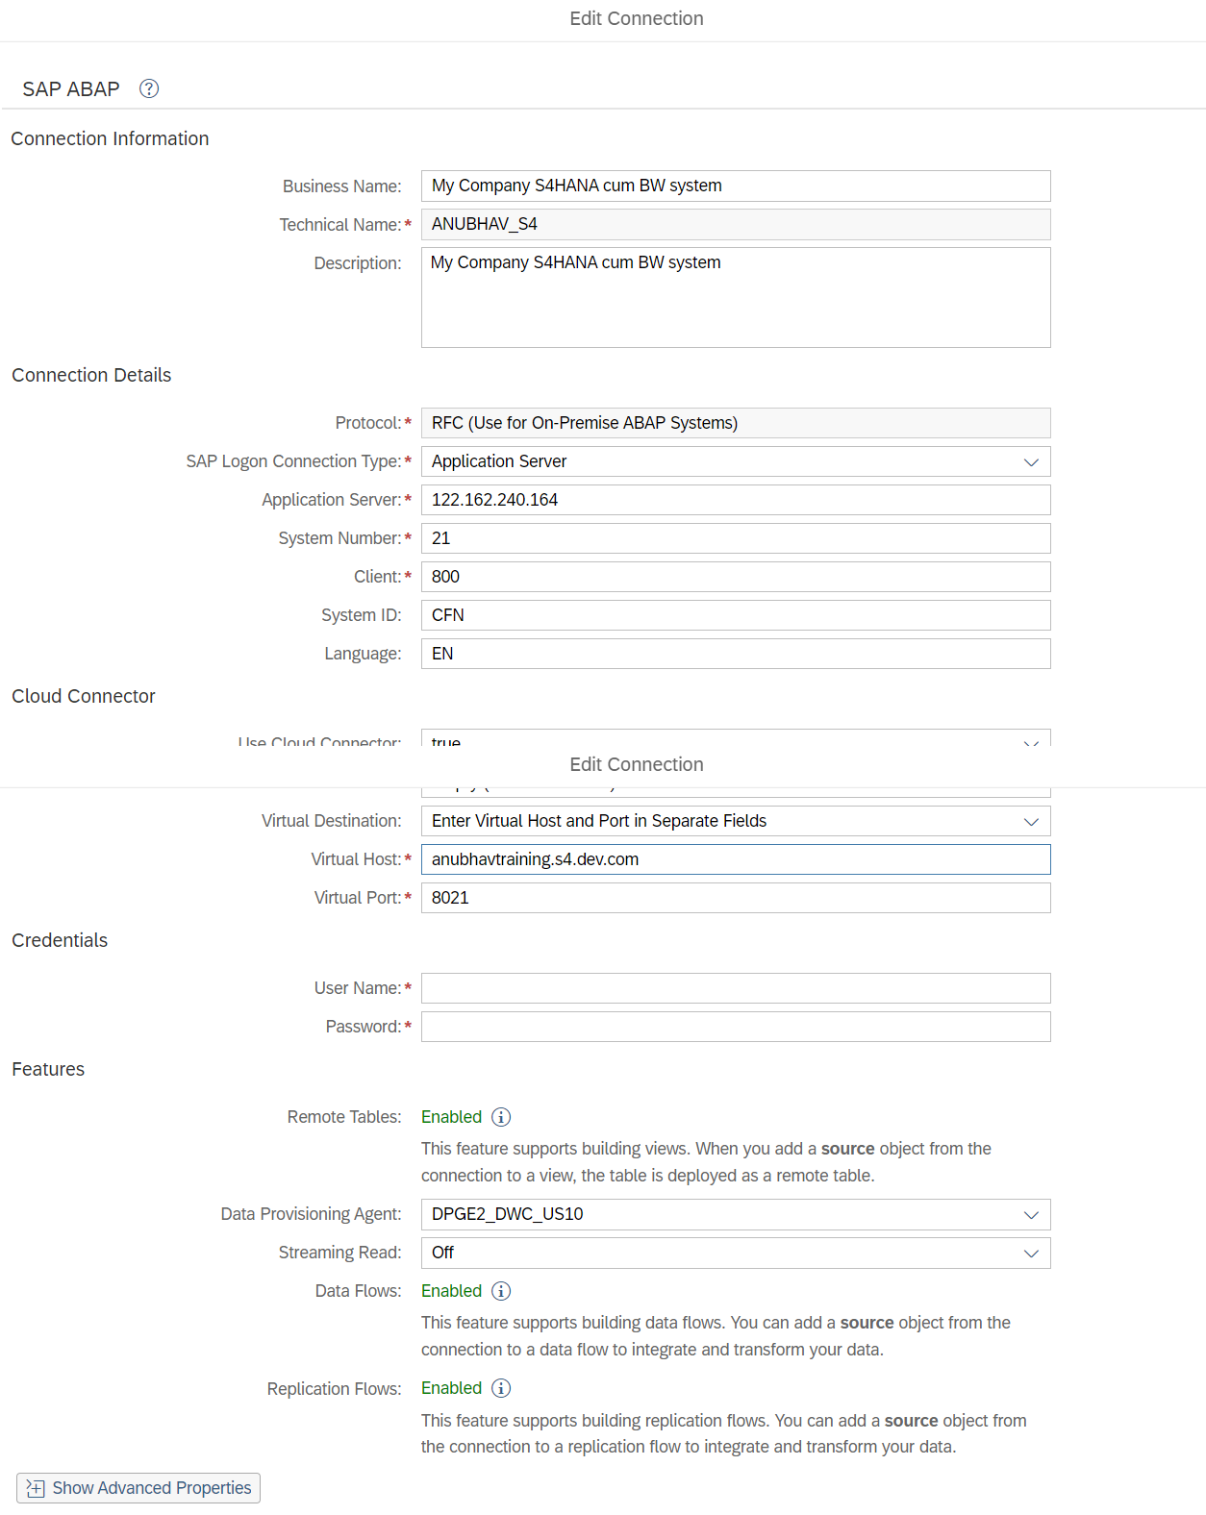

Slide 18
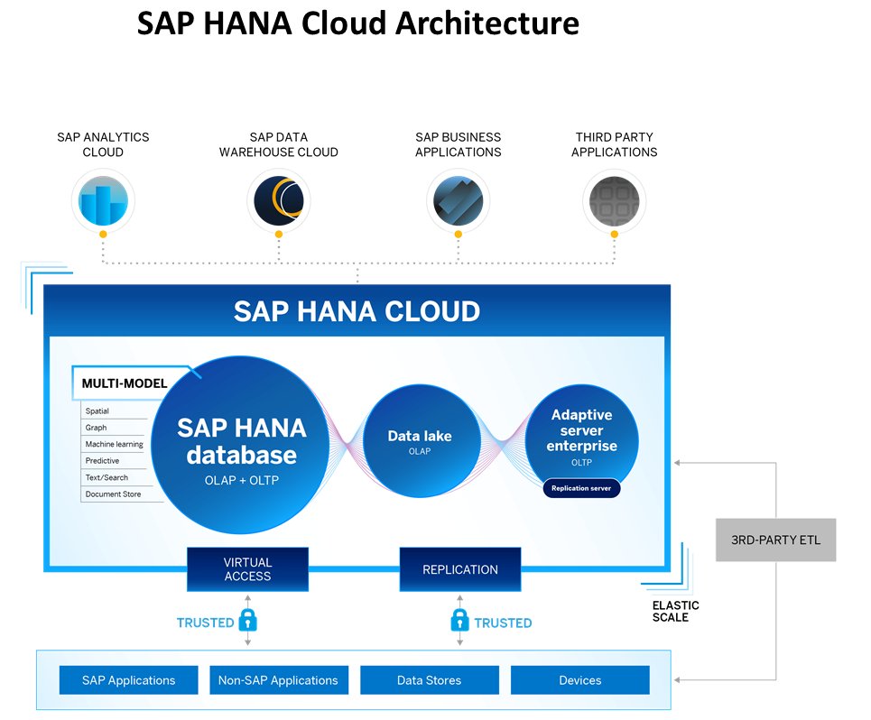
What is SAP HANA Cloud?
SAP HANA Cloud is a fully managed, in-memory, cloud database as a service (DBaaS). It is the cloud-based data foundation for SAP Business Technology Platform. With SAP HANA Cloud you can create, run, and extend new and existing applications.
SAP HANA Cloud includes a number of software components. The core component is SAP HANA Database, but other components can be added at any time, such as a data lake.
Key Components of SAP HANA Cloud
There are four key components of SAP HANA Cloud:
SAP HANA Cloud, SAP HANA Database
In-memory database with built-in advanced analytics (spatial, graph, text, etc.)
SAP HANA Cloud, data lake
Store and query large data sets and most file types
SAP HANA Cloud, adaptive server enterprise
Support for extreme –performance transactional applications
SAP HANA Cloud, adaptive server enterprise replication
Bi-directional real time data replication across databases

Slide 19




























Database / Datawarehouse / Data lake

Slide 20
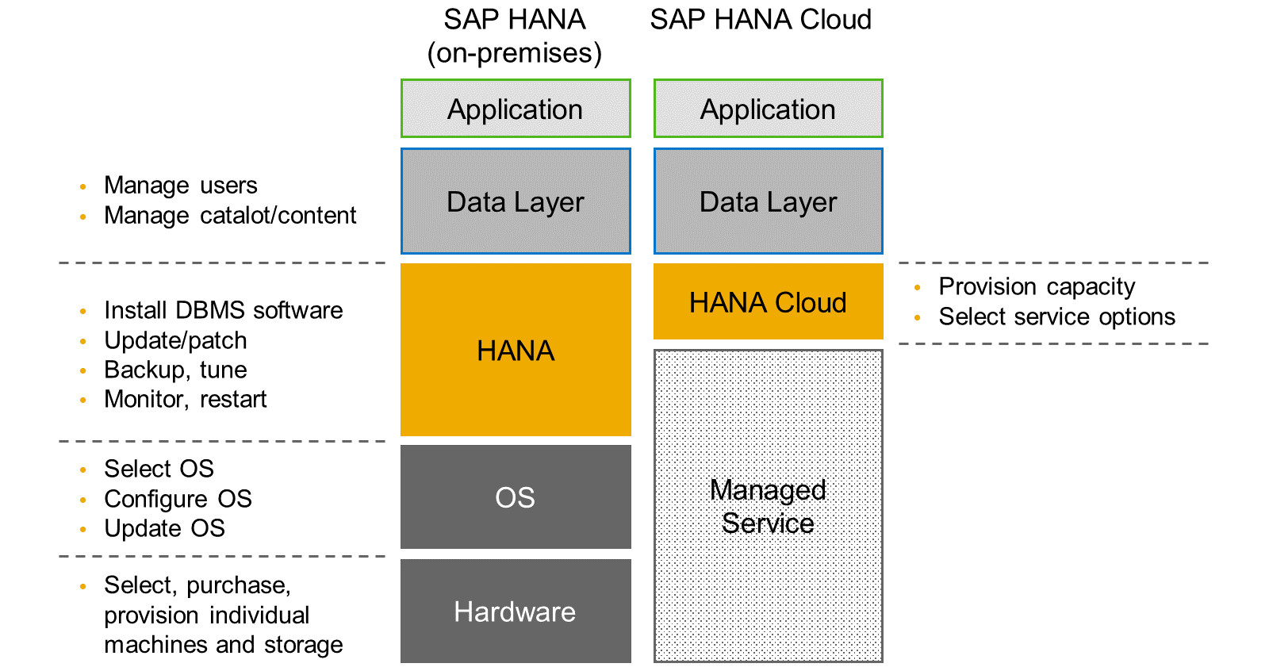
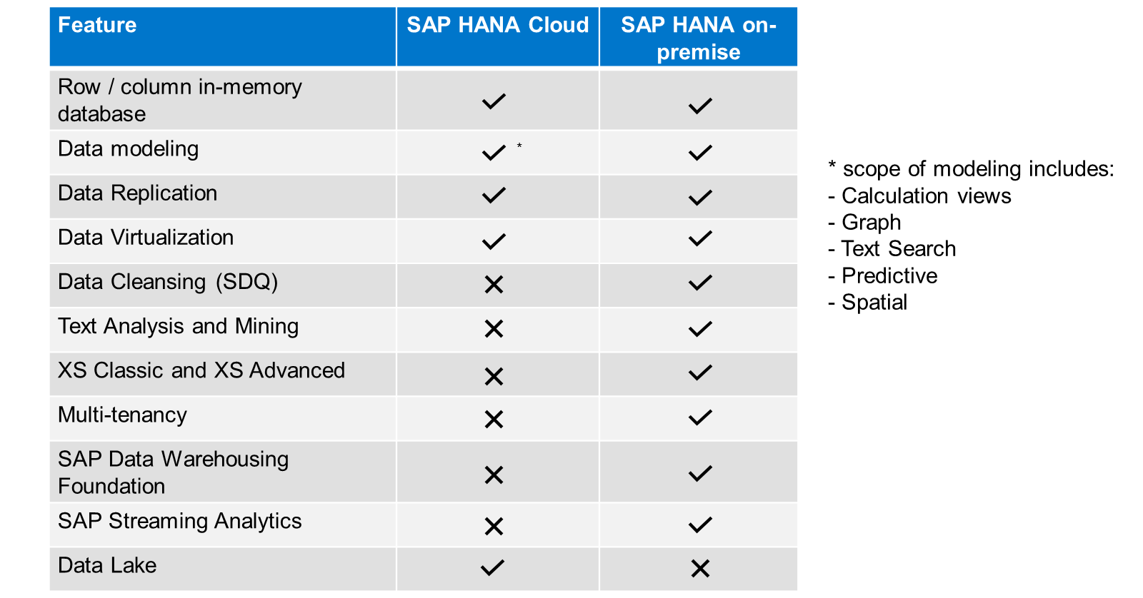
HANA Cloud v/s On-premise
Feature Differences
SAP HANA Cloud compares very closely with SAP HANA on-premise in terms of features but there are some differences.

Slide 21

What is Schema in HANA
Schema – Is a mandatory database object of database which stores other database objects.
It’s a logical separation of database objects.
It is home of all the runtime object
Security
Package – home of design time object
BW
ekko
ECC
ekko
S/4HANA
ekko
SAP HANA 600GB
SCBW
ekko
ECC001
ekko
SAPS4C
ekko
MIG
ekko
SYS

Slide 22
HDI Container
An HDI Container is also a schema. But it is managed differently from a normal schema.
Schema -- How its created?
Manually create it in BTP
Application Managed HDI Container (You as developer ONLY work with App, App will talk to HANA to create and manage this schema to store/read data internally)
You cant access HDI Container using HANA Studio (Deprecated tool), We can use new SAP HANA Database Explorer, SAP HANA WebIDE for OP or BAS to access HDI Container.
HDI -- Who creates it?
There is a new service in SAP HANA called SAP HDI (HANA Deployer Infrastructure) which is just a microservice responsible to managing the container. HDI Deployer is a component which is used to talk to this service from our app.

Slide 23
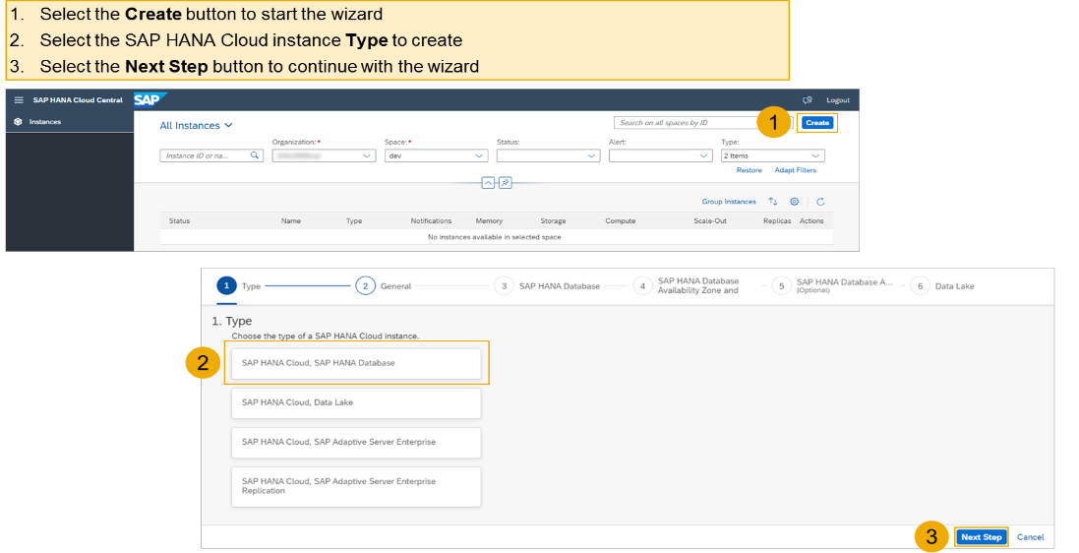
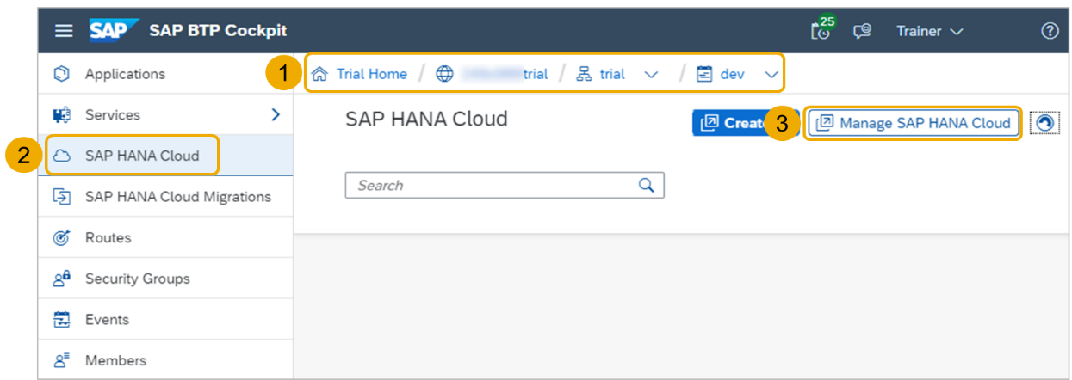
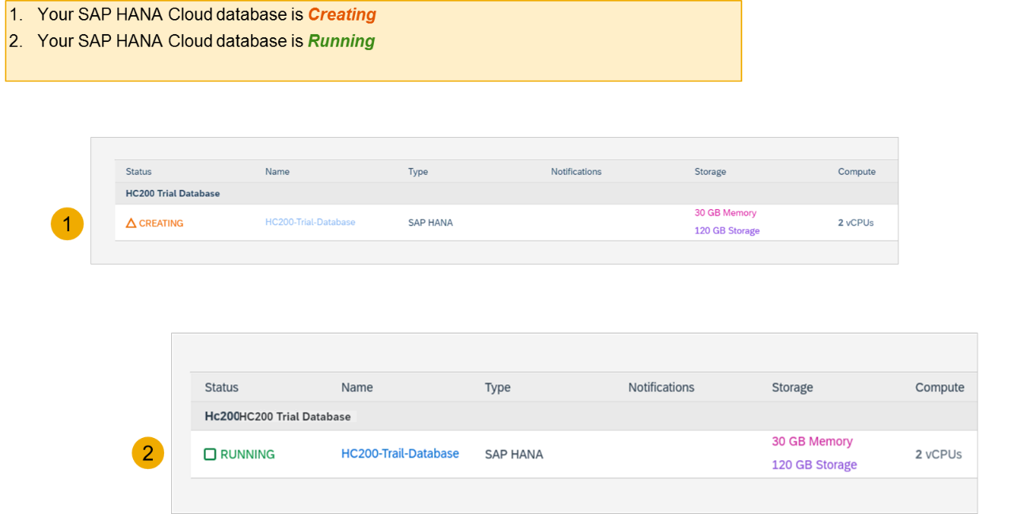
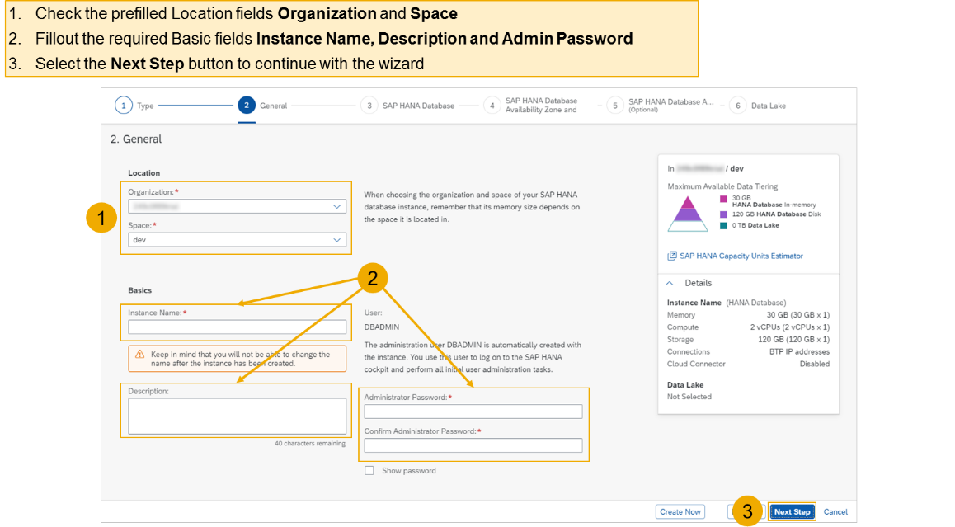
Create HANA Cloud Instance
Login to your trial and navigate to your dev space
Select SAP HANA Cloud
Select the Manage SAP HANA Cloud button to start the SAP HANA Cloud Central
Select the Create button to start the wizard
Select the SAP HANA Cloud instance Type to create
Select the Next Step button to continue

Slide 24
Connect to your HANA Cloud DB

Slide 25
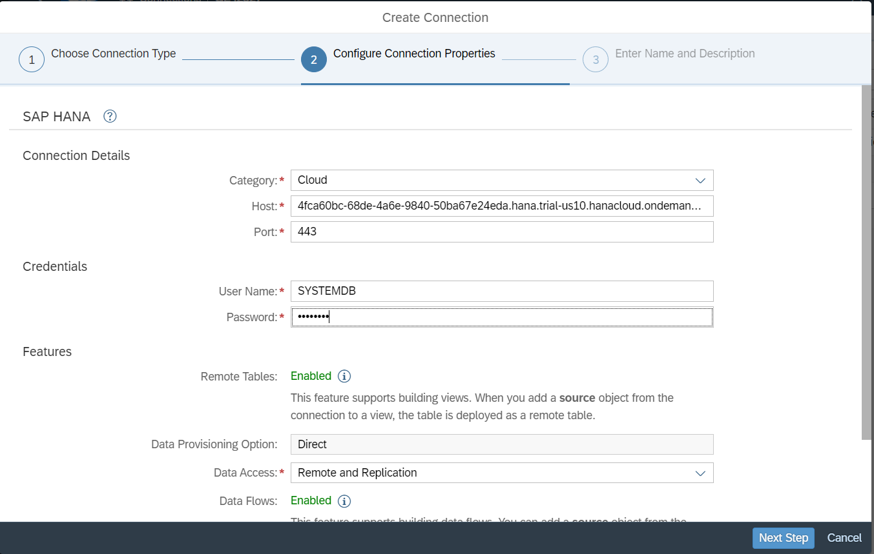
Connect to HANA Cloud from Datasphere
/ DBADMIN

Slide 26
create schema anubhavdemo;
set schema anubhavdemo;
create column table emp(id integer, name varchar(80), salary decimal(10,2), currency varchar(4),
country varchar(2), primary key (id)
);
insert into emp values (1,'Anubhav',5000, 'EUR','IN');
insert into emp values (2,'Megha',8000, 'EUR','IN');
create user ANUBHAV password Welcome1
GRANT SELECT ON SCHEMA SFLIGHT TO ANUBHAV WITH GRANT OPTION

Slide 27
Do we need install and configure DP agent on the on-premise system ? I believe DP agent is on the BTP system, why is sap saying to install DP agent server which hosts DP agent instead of Cloud connector ? Is it for older times ?
It needs to be installed by BASIS on a VM same like cloud connector, No. 2. For NON-SAP on premise systems, still do we need to install Cloud connector similar like on premise SAP systems ? No
3. Dont we need to do any config on DP agent, I know its pre-installed on BTP systems ? but no config changes while configuring BTP system with an on-preimse system.
Yes, will be done by BASIS team 4. Is there any table/reference on SAP help site, which says what connection type configuration to select while connecting to SAP DS.
Yes – TOBE SHARED 5. Is DP agent server called SAP Cloud connector now for SAP DS (atleast) ? why are they saying install DP agenet when we are not doing anything in DP agent ? - No 6. When I search is DP agent same as Cloud connector - I found this statement - Can you please explain ? They are similar, however the Cloud Connector is more SAP-system focused and supports on-premise to Cloud connectivity, whereas the Data Provisioning agent is part of HANA SDI and includes some advanced features such as federation and replication for SAP and non-SAP systems 7. My client has a requirement to extract Finance and Scholarship data from non-sap systems to SAP DS, to extract atleast 800gb of data. Any advise on the license costs or indictive cost and commercials. They want to extract data from 10 internal/external systems. I know its not related to our training, but just some tips.
It is subscription cost for this you need to contact SAP Directly.
Without hana username and password can we upload schema in hana cloud?
No you can use DBADMIN user like I showed
2. if there are three server DEV, qua and prod, so how many data sphere account will be there?

Slide 28
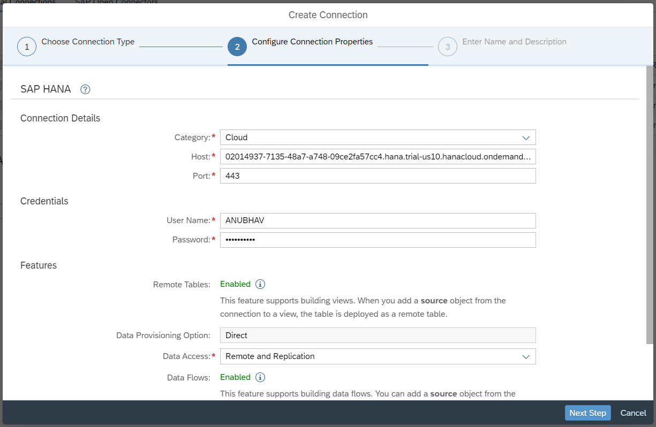

Slide 29

What We Did
Let’s Summarize

Slide 30
www.anubhavtrainings.com
Thank You
End of Day 3

Slide 31


We’re committed to empower you to be
#FutureReady
through powerful training solutions.
We build the workforce of the future.
250+
Corporate Clients
30,000+
Learners Trained
25000+
Learners Placed
FREE WEBINARS
Sign up for free webinars with industry experts every fortnight!
Enroll Now!
Contact us today!
https://anubhavtrainings.com

